Slide 1
Cluster Design & Budgeting
General ideals for achieving computational goals.

Slide 2
Understanding the problem domain
Budget = when, how, why, where, overhead
Development & design involvement
Research & Education
Hardware manufacture contacts
Vendor Contacts, integrators

Slide 3
Understanding the Problem Domain
What are the target points of the cluster?
What are the scientists doing?
What is the main goal of their computation?
What is the expected lifetime?
What is the bound (cpu, memory, message passing)?
What will your involvement be after deployment?

Slide 4
Budget
When – when will the funds be available?
Why – Why are they building this?
How – how will the project be billed, how will you time be billed?
Overhead – the costs that are generated behind the scenes – Lab Taxes, State Taxes, extra supplies (cable ties, etc) – this is at least 22.9% over your quote + F & O costs.
Where – where will the cluster live?

Slide 6
Development and Design Involvement.
The biggest part of development and design is understanding the problem set the scientists are looking at/using.
Where are the bottlenecks?
Is the problem CPU bound?
Is it Memory bound?
Is PCI bus bound (message passing)?
Is it floating point intensive?
What CPU do you use?
AMD
Intel
What is the interconnect that is expected?
Infinaband,
10Gb/s ethernet,
Myrinet (Myricom)?

Slide 7
Intel and AMD CPU specs
Intel
Number of Cores: 288
Number of ex-threads: 576
Total memory (GB): 768
Memory/Core (GB): 2.67
Memory/Thread (GB): 1.33
DATA POINTS:
Introduction Date: 9/10/13
Core Name: Ivy Bridge –EP
Mirco Arch Name: Ivy Bridge
L1 Cache: 384KB(code)/384KB(data)
L2 Cache: 3072KB
L3 Cache: 30720KB
Multiprocessing: 2
Street Price: $2336
AMD
Number of Cores: 512
Number of ex-threads: 512
Total Memory(GB): 1024
Memory/Core (GB): 2
Memory/Thread (GB): 2
DATA POINTS:
Introduction Date: 11/5/12
Core Name: Abu Dahbi
Micro Arch Name: Piledriver
L1 Cache: 512KB(code)/256KB(data)
L2 Cache: 16384KB
L3 Cache: 16384KB
Multiprocessing: 4
Street Price: $703

Slide 8
Storage needs – Need to determine the type of storage needed,
generic NFS?
Lustre?
PanFS?
High-end storage?
Rack Space – how big will this be? What is the foot print?
Power – How much power will this consume?
There is a difference if it CPU based computation vs. GPU (Telsa) based computation.
Cooling – We don’t worry about this much here, however, it’s good to know.
As much as 1/3 of the total wattage used is expelled as heat. This will give you an over estimate, use it.

Slide 9
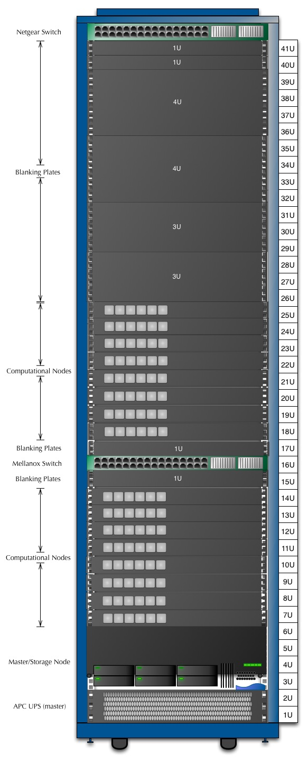

Slide 10
Research & Education
Take the time to understand the problems the scientists are working on.
What is new out in the market place?
Do comparison shopping, CPU, Memory, Storage, i.e. -> Intel VS AMD.
http://www.cpu-world.com/Compare/995/AMD_Opteron_6300_series_6328_vs_Intel_Xeon_E5-2650_v2.html
Understand the CPU options (see the comparison shopping), there are other minor differences that could provide better results, i.e. floating point unit.
What settings will optimize the problem set?
BIOS?
NUMACTL?
SYSCTL?

Slide 11
Hardware Manufacturer Contacts
Talk to peers, find out who they know
Most important to find out key developments in hardware. The hardware you’re building should be viable in 3 years.
The newest and best can be $$$ but it gives a cutting edge.
Work on getting samples, give aways, short term loans.
If you attend a conference, talk to Manufacturers – 1st tier – AMD, INTEL, NVIDIA, ATI, etc., ask them to show you the latest, get business cards.

Slide 12
Vendor Contacts, Integrators
Who are they? What are they selling?
Check and recheck that hard specs in the quote, as well as all the items – ask do you need them?
Will the vendor allow you to diagnose the problem and send you a replacement in cross- shipment? F&O help?
Will the vendor talk with you about changes and stand by your expertise?
What is the vendors experience?
What are their warranties? How long is it? Will they honor hardware parts warranties (ex. Seagate drives are 5 years?).
Will you be able to talk with the engineers at a vendor? Will they give you a tour of their facility?

